Slide 1
Generational Communications Styles
NAEBA National Conference - Discussion Session

Slide 2
Discussion Topics
Introduction to Generational Communications Styles
The Five Generations at Play Today
Characteristics of Each Generation
Communications Challenges
Strategies for Effective Communications
Case Studies
Conclusions and Q&A

Slide 3
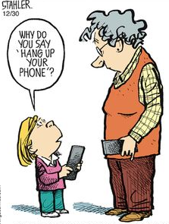
Generational Communication Styles
What are generational communications styles?
Each generation is heavily influenced by personal, cultural, social and psychological factors that affect their behavior and impact when, where, why and how they need to adapt and receive information.
Differences are along more dimensions than you may think

Slide 4
The Five Generations in Play Today
Formative
Experiences
Maturists
(pre-1945)
Wartime
rationing
Rock’n’roll
Nuclear families
Defined gender roles, particularly for women
Baby
Boomers
(1945-1960)
Cold war
Swinging Sixties
Moon landings
Youth culture
Woodstock
Family Oriented
Gen X
(1961-1980)
Fall of Berlin
Wall
Reagan/
Gorbachev/ Thatcherism
Live Aid
Early mobile tech
Divorce rate rises
Millennials
(1981-1995)
9/11 terrorist’
attacks
Social media
Invasion of Iraq
Reality TV
Google Earth
Gen Z
(After 1995)
Economic
downturn
Global warming
Mobile devices
Cloud computing
Wiki-Leaks
Attitude Towards Career
Jobs for Life
Career defined by employees
Portfolio careers – loyal to profession not employer
Digital entrepreneurs work “with” organizations
Move seamlessly between organizations and “pop-up” businesses
Defining
Product
Automobile
Television
Personal Computer
Tablet / Smartphone
3D Printing / Virtual Reality
Communication
Channel
Formal Letter
Telephone
Email and Text
Text and Social
Text and Social
Preference for
Financial Decisions
Face-to-face meetings
Face-to-face telephone
Face-to-face, telephone, online
Face-to-face
Fluid / Zoom

Slide 5
Maturists (Pre-1945)
The generation born into the Great Depression and World War II communicated heavily in person and via handwritten letters.
With WWII in particular, communication with loved ones could be sporadic, and people often relied upon the written letter to convey many thoughts in one place, without interruption.
Because goods and services were not always available immediately, this generation became accustomed to delayed gratification.
Prevalence of military life also drove a strong emphasis on hierarchy, respect for seniority, structure and honesty.
As a result, people of this generation tend to learn via long written communication that includes clear explanations of thought, and they often want to be able to “look someone in the eye.”

Slide 6
Baby Boomers (1945-1960)
Boomers had the radio at their fingertips, as well as predominantly black-and-white TV.
This is the generation that heard, or saw, the moon landing from their living rooms.
This generation’s learning style tends to be more auditory—they want people to talk to them, in person or on the phone.
They enjoy a good discussion. But similar to Maturists, they tend to have a healthy respect for hierarchy, are loyal and think everyone should pay their dues.
Most also greatly value work and tend not to prioritize retirement.

Slide 7
Generation X (1961-1980)
With women more prevalent in the workforce again and divorce rates rising, these Gen X “latchkey” kids were often left to hang out at home by themselves with their color TVs.
As a result, many became independent, self-reliant and free-thinking.
This generation invented email grew up during a time of disillusionment. From the Vietnam War to Nixon’s Watergate scandal to the Challenger explosion, their trust in authority crumbled in many facets.
As a result, this typically skeptical generation showed less respect for service, title or rank and instead valued competence and individuality.
Their preferred learning style tends to be visual—they want to see what’s happening and how it works.

Slide 8
Millennials (1981-1995)
One of the most talked about generations is the one that grew up during the digital revolution and the advent of smartphones.
They’ve lived life with and without digital technology.
This generation grew up with diverse and merged families and typically closer family relationships.
Smartphones enabled connections across the globe and helped create and maintain relationships.
Generally crushed by debt and hit with inequity at home and at work, many in this tech-savvy generation became more creative, empathetic and aware of global issues than the previous generations.
Chat (instant messenger) and text messages enabled this generation to give and receive information more quickly than others.
This generation often learns best kinesthetically (they learn by doing). In my opinion, they are multitaskers who like getting things done and dislike wasting time. They typically value diversity, making a difference and immediate feedback.

Slide 9
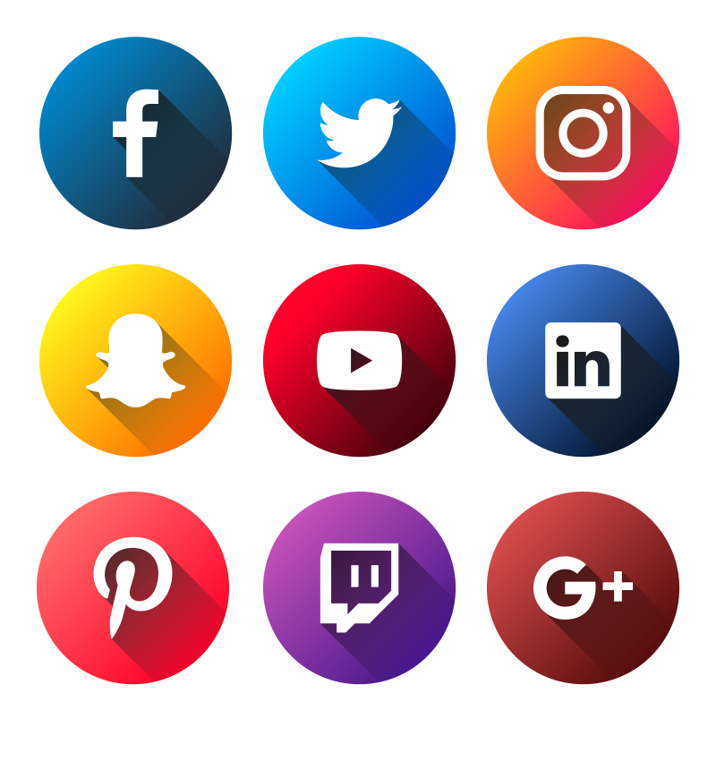
Gen Z (Post 1995)
Gen Z builds on many of the Millennial characteristics.
They are an increasingly diverse population and care deeply about issues such as equality, diversity and climate change.
They are often more activist in nature and want to see government involved in solutions to large, entrenched problems.
Shaped by the global pandemic, they tend to learn from, and be driven by, social media—Twitter, Instagram, Snapchat and TikTok (Facebook is "for the oldies")—and value short, quick bursts of thought that are relevant to the current conversation.
Having grown up with technology, they are digital natives.
Their world changes rapidly, and they tend to move quickly to stay current. Anything that moves too slowly is often rendered irrelevant or obsolete.

Slide 10
Texture Break

Slide 11
Key Takeaways
Maturists
From the Maturists, we learn patience, institutional knowledge and long-term perspective.
Baby Boomers
From the Boomers, we learn dedication, perseverance and realism.
Generation X
From Generation X, we learn pragmatism, independence and healthy skepticism.
Millennials
From Millennials, we learn diversity, empathy and a global perspective.
Generation Z
From Generation Z, we learn equality, activism and staying current.

Slide 12
Discussion Topics
Introduction to Generational Communications Styles
The Five Generations at Play Today
Characteristics of Each Generation
Communications Challenges
Strategies for Effective Communications
Case Studies
Conclusions and Q&A

Slide 13
Challenges Communicating Between Generations
Technology
Divide
Communication Medium Preferences
Language and
Jargon
Younger generations, such as Millennials and Generation Z, are often more tech-savvy than older generations, like Baby Boomers or Generation X.
This can lead to misunderstandings when discussing or using technology-related terms and tools.
Different generations may have preferred communication mediums.
For example, older generations might prefer phone calls or face-to-face conversations, while younger generations may prefer texting or social media.
This can lead to misalignment in communication methods.
Each generation may have its own set of jargon, acronyms, and slang.
Understanding and using this language correctly can be challenging when communicating across generations.

Slide 14
Challenges Communicating Between Generations
Feedback
Styles
Respect for
Authority
Attitudes Towards
Change
The way each generation gives and receives feedback can differ significantly.
Younger generations may be more open to frequent feedback, while older generations may prefer more traditional, less frequent feedback.
Older generations may place a higher value on hierarchy and authority, while younger generations may have a more casual approach to authority figures.
This can affect the dynamics and communication across parties involved in the real estate transaction.
Younger generations often embrace change and innovation more readily than older generations, who may be more resistant to change.
This can lead to disagreements about the adoption of new technologies or work processes.

Slide 15
Challenges Communicating Between Generations
Values and
Priorities
Communication
Speed and Frequency
Generational
Stereotypes
Generational differences in values, such as work-life balance, career aspirations, and social responsibility, can impact how individuals from different generations communicate and make decisions.
Younger generations tend to communicate quickly, often expecting rapid responses, while older generations may be more patient and considerate in their response times.
Preconceived notions and stereotypes about different generations can create communication barriers.
Assuming that all members of a particular generation think or act a certain way can lead to misunderstandings.

Slide 16
Discussion Topics
Introduction to Generational Communications Styles
The Five Generations at Play Today
Characteristics of Each Generation
Communications Challenges
Strategies for Effective Communications
Case Studies
Conclusions and Q&A

Slide 17
Strategy 1 – Listen Actively and Intently
Listen attentively to what the other person is saying and try hold back on interrupting.
Listen, not only to WHAT they are saying, but to HOW they are saying it.
You can often get generational ‘queues’ for the words they use

Slide 18
Strategy 2 – Keep Your Mind Open
It is human nature to immediately put your ‘lens’ on what others are saying. Try not to.
Try to examine and internalize your client’s messages before reacting
Avoid making assumptions or stereotypes about people based on their cultural generation . . . We often do this without even realizing it

Slide 19
Strategy 3 – Adapt Your Communication Style
Tailor your communication style to that of your client.
If clients prefer short, factual, efficient conversations try to mirror that. If they prefer wandering redirection . . . Follow their lead.
Always ask about your client’s preferred communication method – phone call? Email? Text?
No matter what generation your working with, it is ALWAYS best to use clear and straightforward language, avoiding jargon or slang that might be unfamiliar to the other person.

Slide 20
Strategy 4 – Use Tech Wisely
Embrace technology when appropriate, but be patient when working with older generations who may not be as tech-savvy.
Offer assistance and guidance in using digital tools if needed.
Nothing is more befuddling to ALL generations is Teams and Zoom. Plan plenty of time to get your meeting up and running!

Slide 21
Strategy 5 – Watch for Non-Verbal Clues
Pay attention to nonverbal cues like body language and facial expressions, which can convey messages beyond words.
Ensure your nonverbal communication aligns with your intended message.
Arms crossed, leaning back, face wrinkle, brow raise . . .all tell you something

Slide 22
In Summary . . .
The path from referral to close is hard enough to navigate . . .
Referral
Close
Improving your cross-generation communications skills can help ease the journey

Slide 23
Discuss

